Slide 1


AWS Redshift

Slide 2
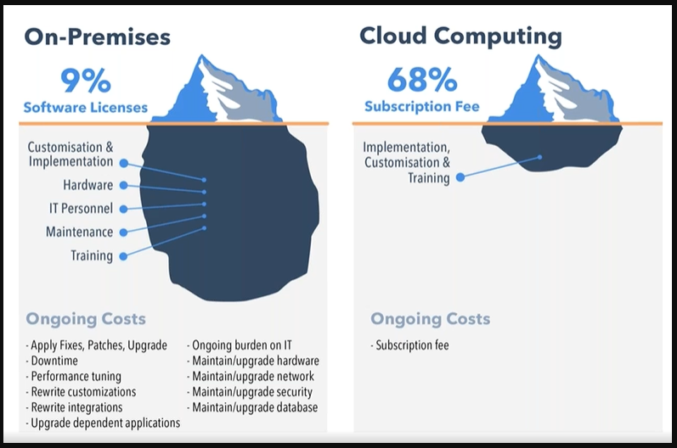

Slide 3
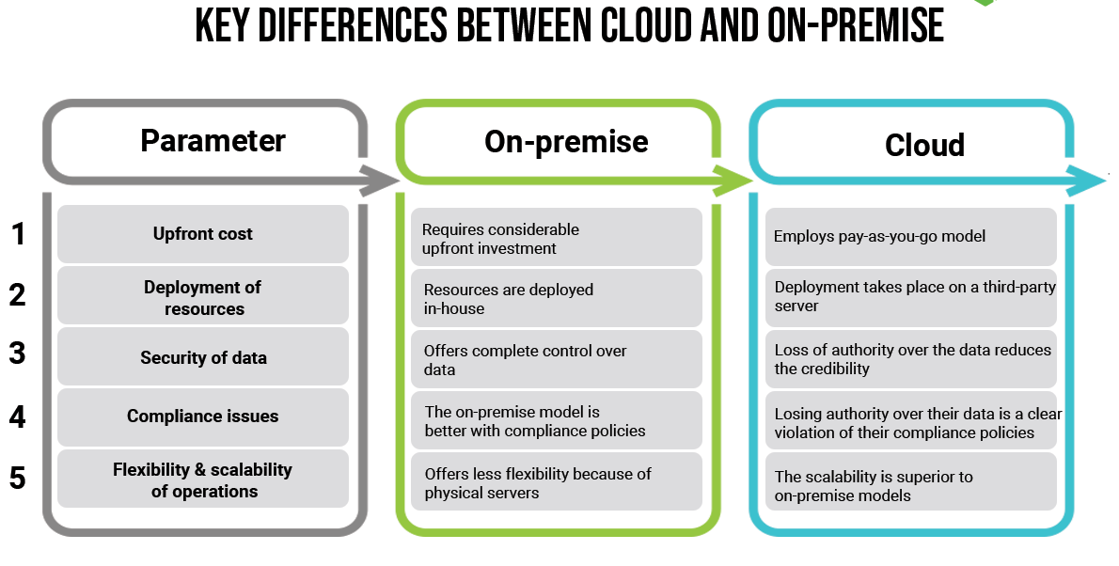

Slide 4
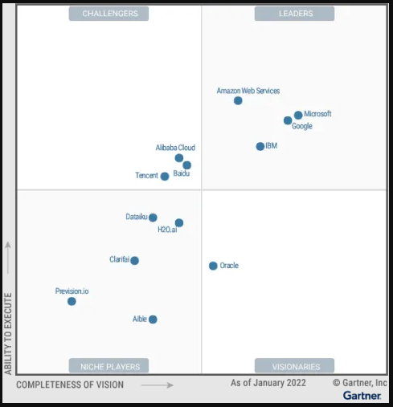

Slide 5
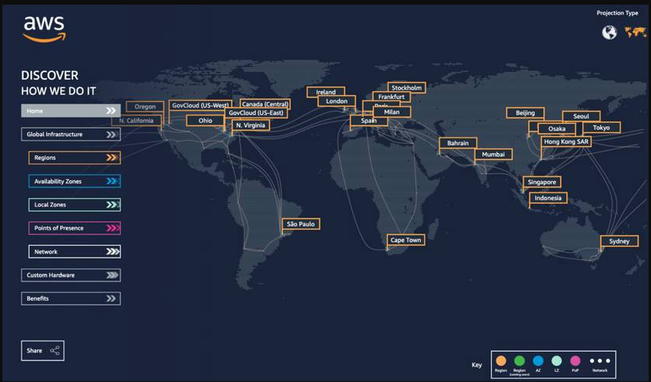

Slide 6
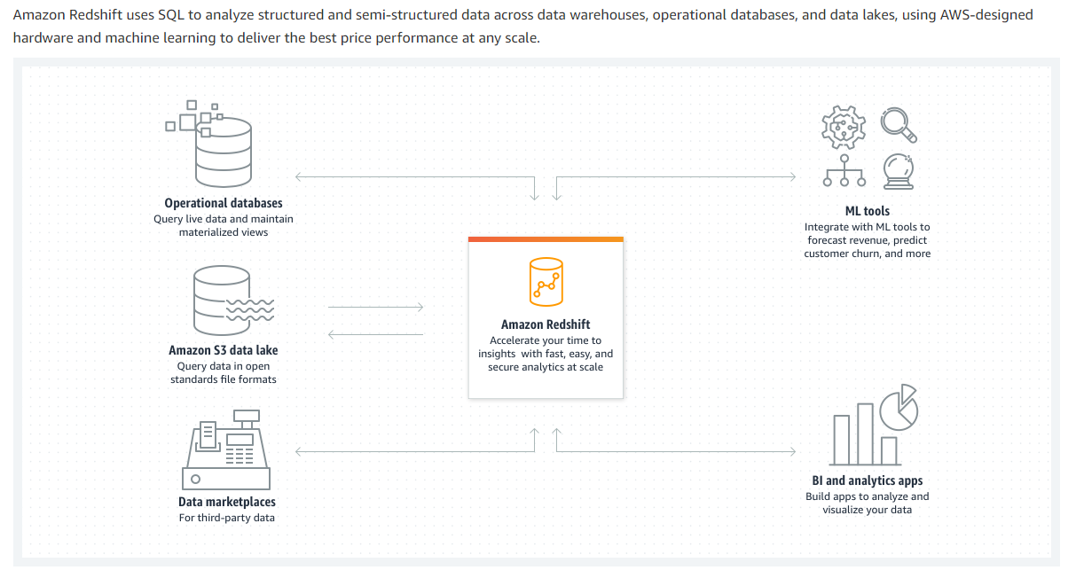

Slide 7
AWS Redshift is a popular data warehousing solution that can handle data on an exabytes scale.
You may be considering the service for a number of use cases such as processing real-time analytics,
combining multiple data sources, log analysis, or more.
Made possible by its Massively Parallel Processing (MPP) technology, Redshift is able to execute operations
on a humongous volume of data at lightning speed — while typically costing only a fraction of what competitors
like Oracle and Teradata charge for comparable products.

Slide 8
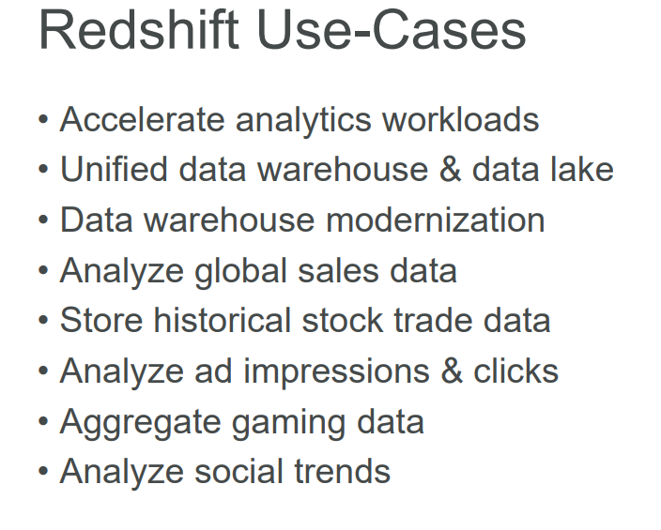
When Would You Want To Use Amazon Redshift?
Real-time analytics
Combining multiple data sources
Business Intelligence

Slide 9
The Benefits of Using AWS Redshift
Speed: With the use of MPP technology, the speed of delivering output on large data sets is unparalleled.
Data Encryption:
Amazon provides the facility for data encryption for any part of Redshift operation.
You as the user can decide which operations need encryption and those that do not need encryption.
Data encryption provides an added layer of security.
Use familiar tools: Redshift is based on PostgreSQL.
All the SQL queries work with it. Additionally, you are free to choose any SQL, ETL (Extract, Transform, Load), and Business Intelligence (BI) tools
you are familiar with. There is no requirement to use the tools provided by Amazon.
Query Volume:
The MPP technology shines in this aspect. You can send thousands of queries to the dataset at any given time.
Still, Redshift will not slow down in any shape or form. It will dynamically allocate processing and memory resources to handle higher demand.

Slide 10
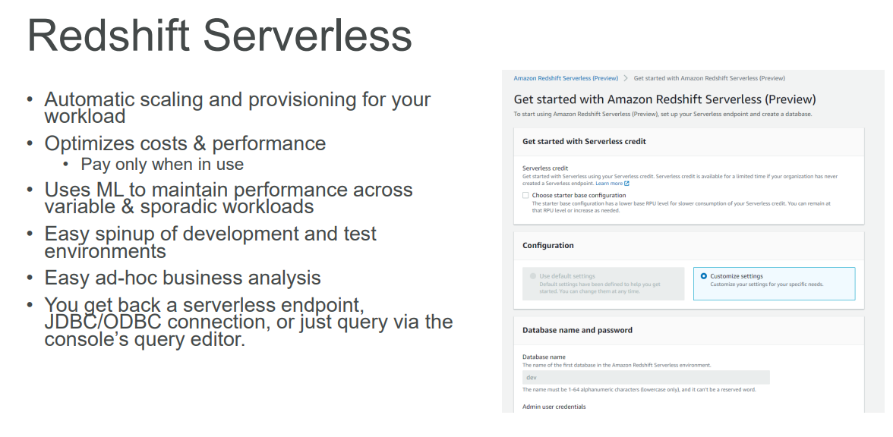

Slide 11
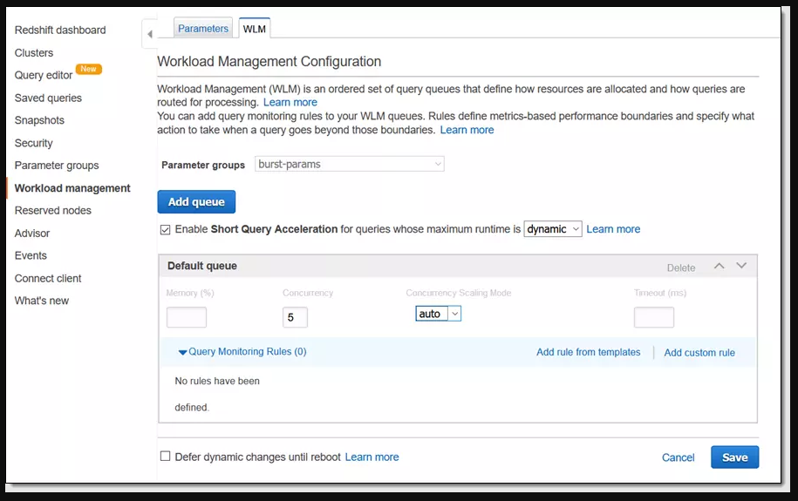
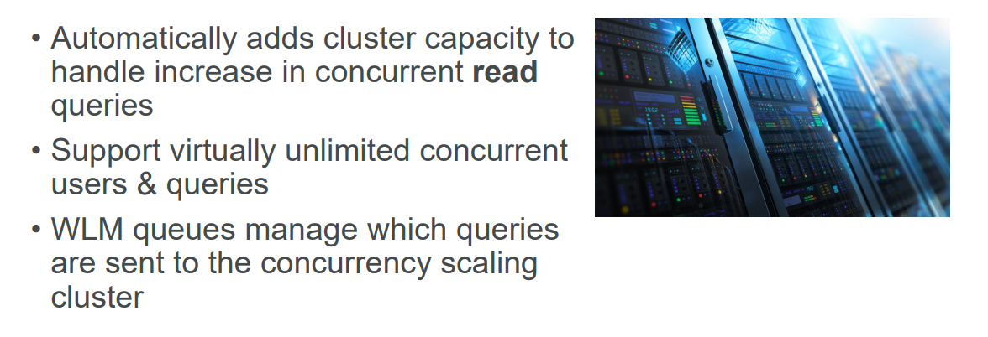
Concurrent Scaling: AWS Redshift will scale up automatically to support increasing concurrent workloads

Slide 12
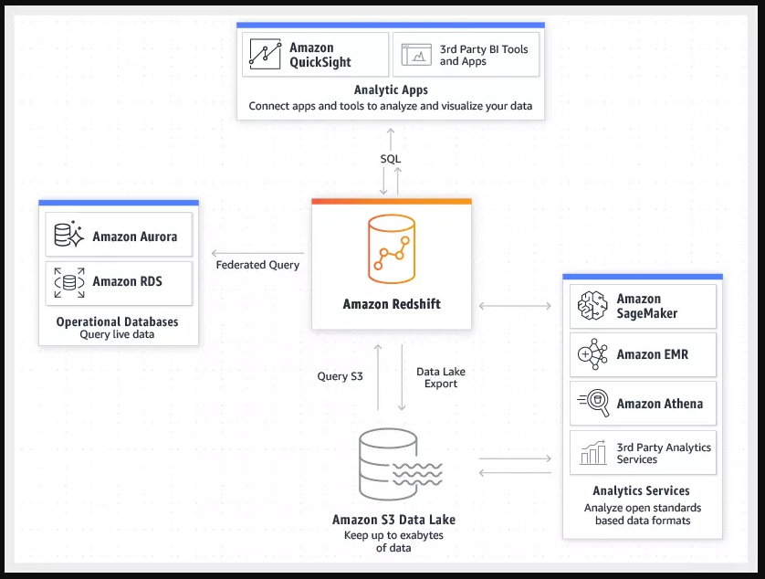
AWS Integration: Redshift works well with the rest of the tools from AWS.
You can set up the integrations between all the services according to your needs and optimal setup.

Slide 13
Columnar database: a smart choice for data warehouses
A columnar database stores data by columns rather than by rows, which makes it suitable for analytical query processing, and thus for data warehouses.
Columnar databases have been called the future of business intelligence (BI).
They're often used in data warehouses, the structured data repositories that businesses use to support corporate decision-making.
Businesses extract data from multiple sources, including cloud-based applications and in-house repositories, and pipe it in batches to these data warehouses,
where it serves as the basis for BI tools. Data warehouses benefit from the higher performance they can gain from a database that stores data by column rather than by row.
Why are columnar databases faster for data warehouses? Storage systems have to pull data from physical disk drives,
which store information magnetically on spinning platters using read/write heads that move around to find the data that users request.
The less the heads have to move, the faster the drive performs.
If data is kept closer together, minimizing seek time, systems can deliver that data faster.

Slide 14
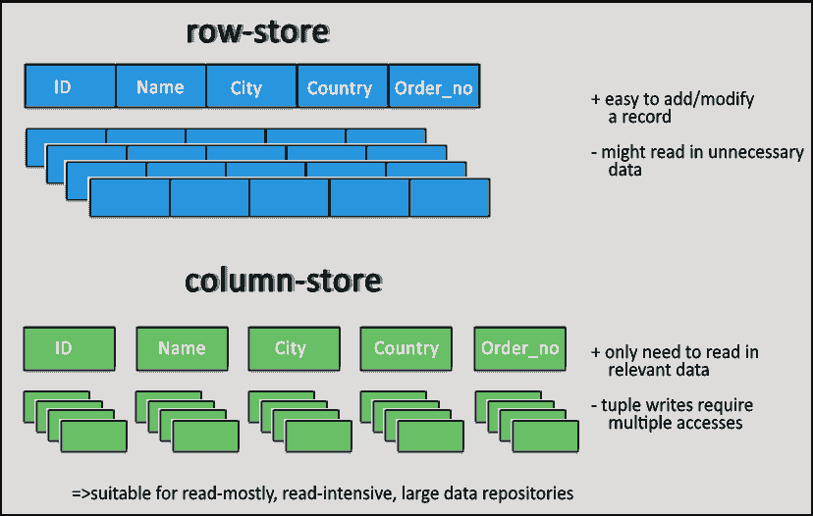

Slide 15
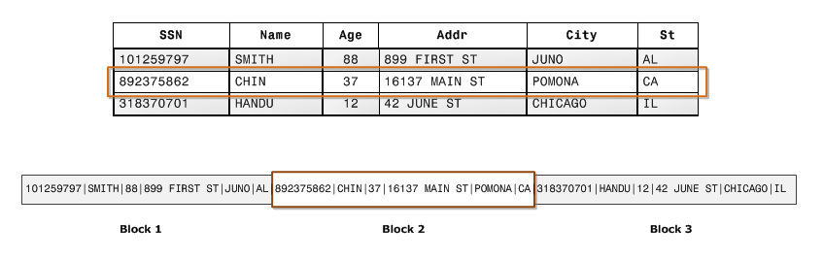
Columnar storage
Columnar storage for database tables is an important factor in optimizing analytic query performance
because it drastically reduces the overall disk I/O requirements and reduces the amount of data you need
to load from disk.
The following series of illustrations describe how columnar data storage implements efficiencies and how
that translates into efficiencies when retrieving data into memory.
This first illustration shows how records from database tables are typically stored into disk blocks by row.

Slide 16
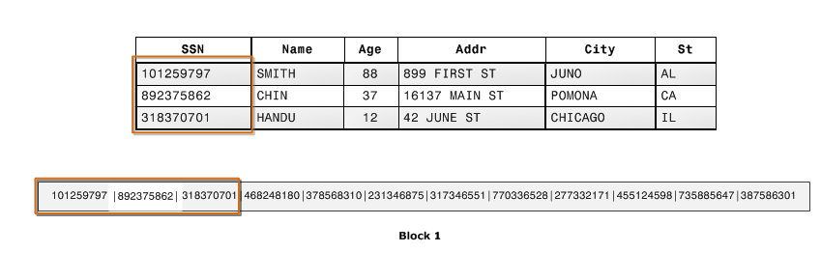
Using columnar storage, each data block stores values of a single column for multiple rows.
As records enter the system, Amazon Redshift transparently converts the data to columnar storage
for each of the columns.
In this simplified example, using columnar storage, each data block holds column field values for as many
as three times as many records as row-based storage.
This means that reading the same number of column field values for the same number of records requires
a third of the I/O operations compared to row-wise storage.
In practice, using tables with very large numbers of columns and very large row counts, storage efficiency is even greater.

Slide 17
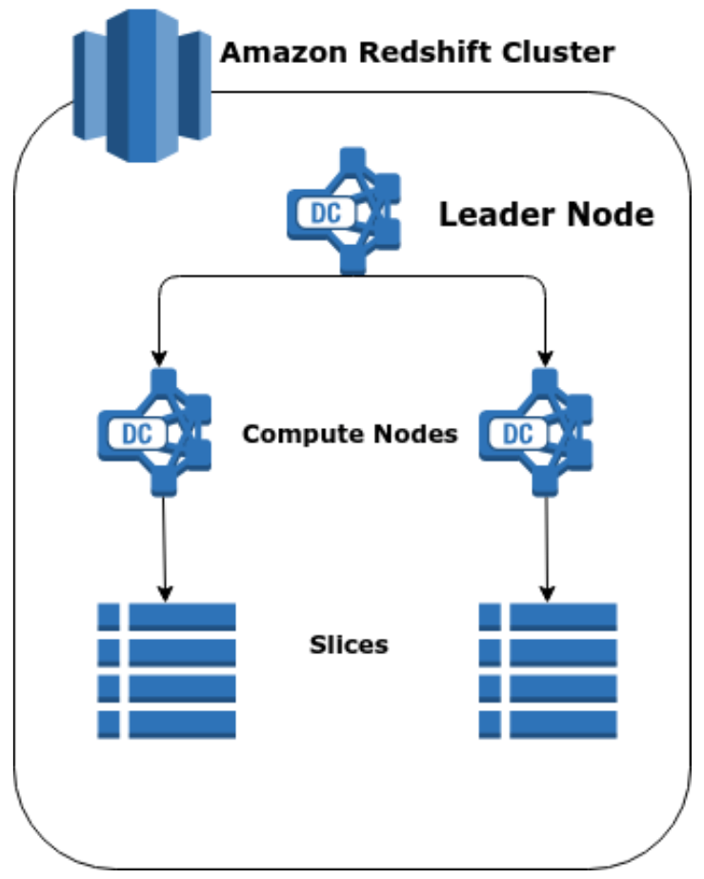
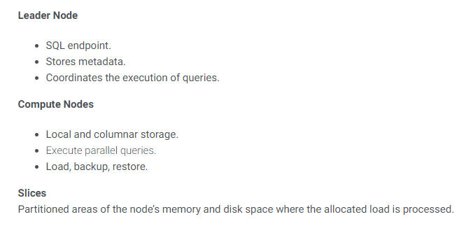

Slide 18
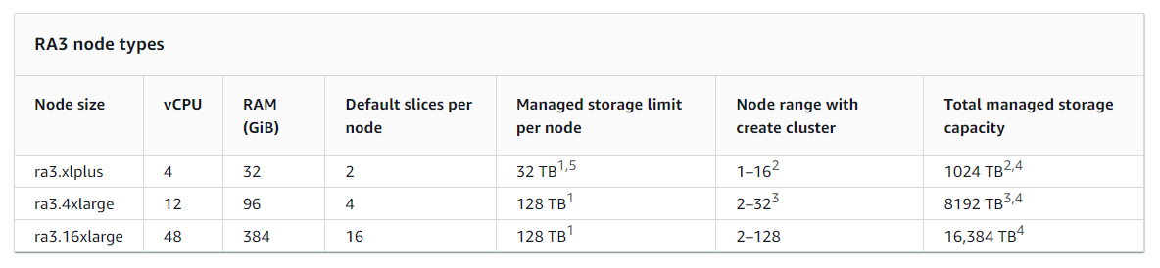

Slide 19
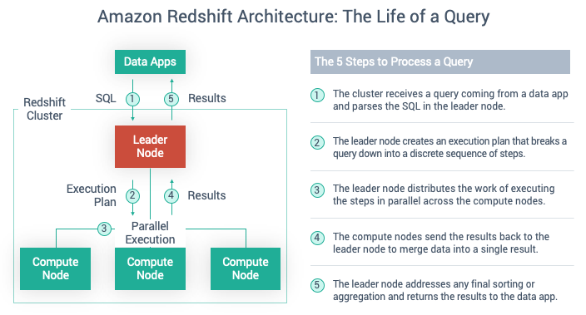

Slide 20
Amazon Redshift snapshots
Snapshots are point-in-time backups of a cluster. There are two types of snapshots: automated and manual.
Amazon Redshift stores these snapshots internally in Amazon S3 by using an encrypted Secure Sockets Layer (SSL) connection.
Amazon Redshift automatically takes incremental snapshots that track changes to the cluster since the previous automated snapshot.
Automated snapshots retain all of the data required to restore a cluster from a snapshot.
You can create a snapshot schedule to control when automated snapshots are taken, or you can take a manual snapshot any time.
When you restore from a snapshot, Amazon Redshift creates a new cluster and makes the new cluster available before all of the data is loaded,
so you can begin querying the new cluster immediately. The cluster streams data on demand from the snapshot in response to active queries,
then loads the remaining data in the background.

Slide 21
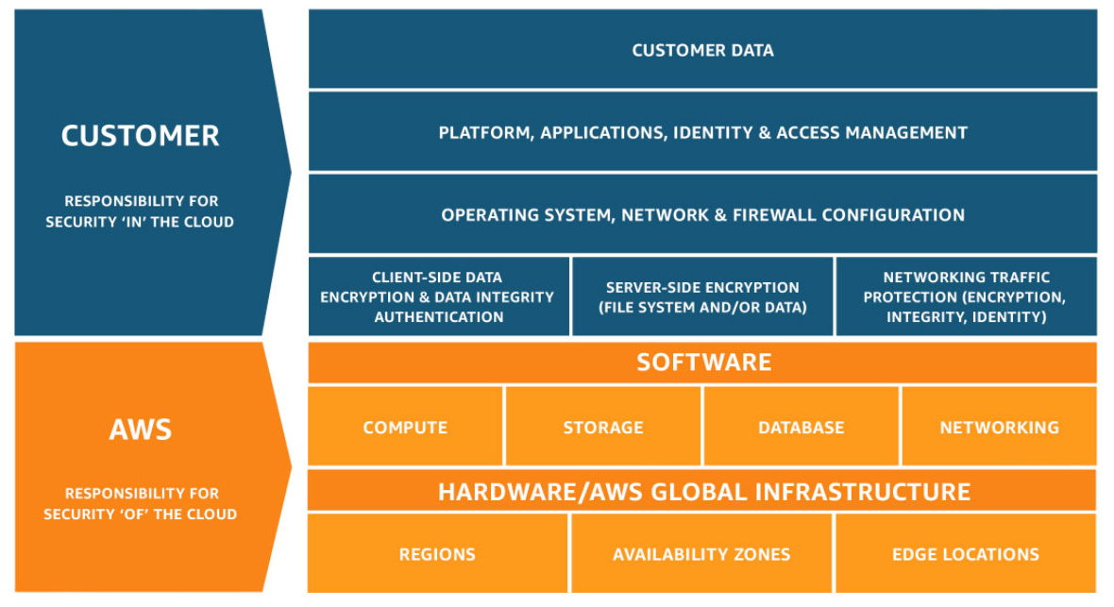
Data protection in Amazon Redshift
The AWS shared responsibility model applies to data protection in Amazon Redshift.
As described in this model, AWS is responsible for protecting the global infrastructure that runs all of the AWS Cloud.
You are responsible for maintaining control over your content that is hosted on this infrastructure.

Slide 22
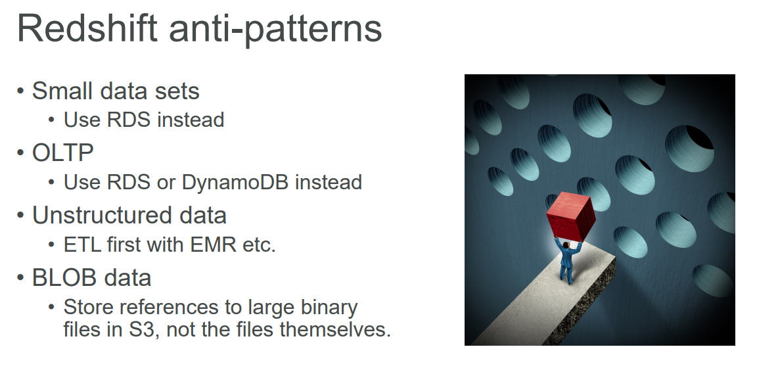

Slide 23
Advanced Redshift use-case
Using Redshift, you may create, train and deploy machine learning models using SQL commands – by taking advantage of Sagemaker, a fully managed machine learning service from AWS.
Split the dataset into training & test data
Use the CREATE MODEL command and specify the training data set (as a table or a SELECT statement)
Redshift ML then compiles and imports the trained model inside the Redshift data warehouse
An inference function is prepared that can be used in SQL queries immediately
All the steps needed to train and deploy a model are automatically handled
You can embed predictions like fraud detection, risk scoring, and churn prediction directly in queries and reports
You may also use models that have been trained externally

Slide 24
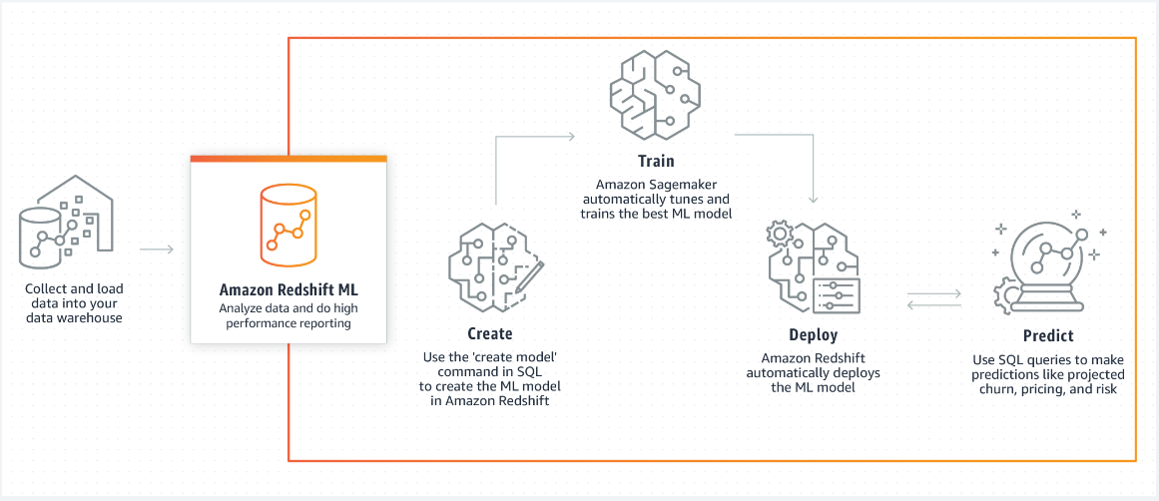
Advanced Redshift use-case

